Slide 1

Zero-Click Phishing in Outlook and the Rise of
AI-Driven Email Security​
Ooni Pizza Oven raffle at the end of the webinar
Gil Friedrich | Co-Founder of Avanan | VP, Email Security
Jonathan Irving | Head of EMEA Sales, Email Security
June 22nd, 2023

Slide 2
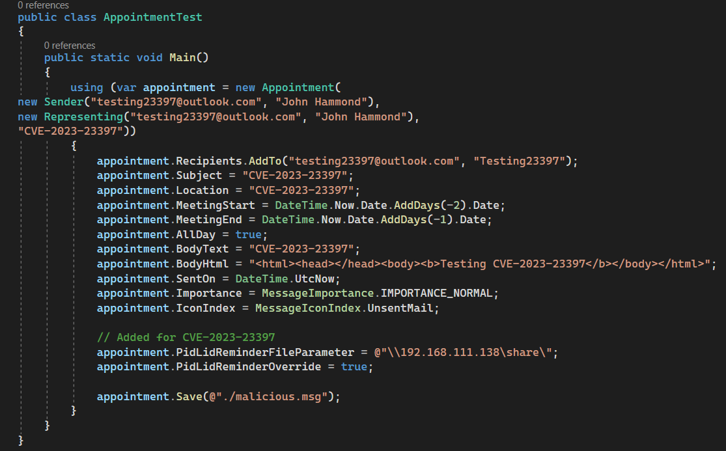
What is CVE-2023-23397? The Zero Click Attack
  In March, Microsoft disclosed a vulnerability impacting Outlook with a 9.8 CVSS Rating
  CVE-2023-23307 allows hackers to send an email with a malicious payload that causes the Outlook client to automatically disclose NTLM hashes (format in which user passwords are stored on Windows)
  The attack utilizes a Universal Naming Convention that allows for a custom notification sound for things like meeting reminders
Notes:
Number of customoer graph

Slide 3
What is CVE-2023-23397? The Zero Click Attack
  No need to click, no interaction needed
  Exploit happens during Outlook processing upon arrival to the client-side
  Triggered when victim’s client is prompted and notified even before message preview
  This attack only affected Windows Outlook desktop client
  This attack was mostly done through a calendar invite. The .msg file arrives at the Outlook server & initiating a connection for NTLM authentication
Notes:
Number of customoer graph

Slide 4
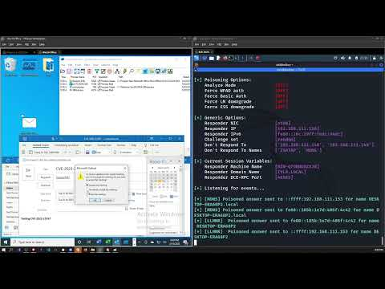
CVE 2023-23397 In Action

Slide 5
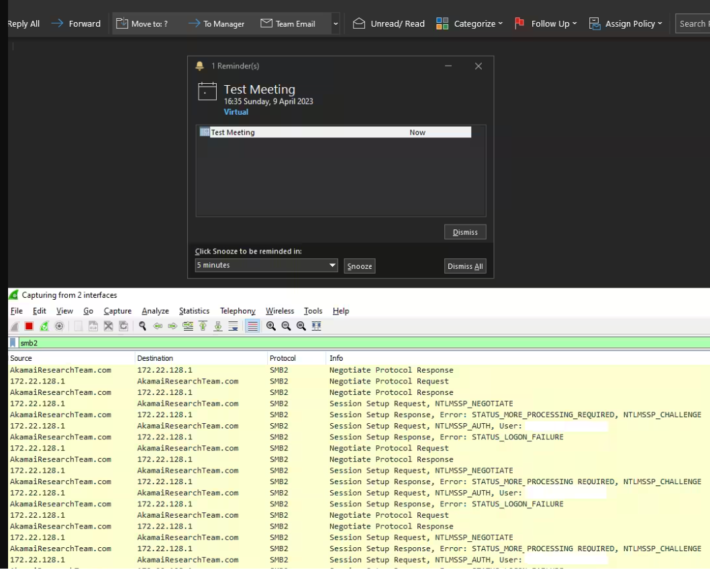
Part 2: CVE-2023-29324
  May 9th, 2023 - New vulnerability released
  Designed to exploit the original patch MSFT put in place
  Vulnerability is in the MSHTML Platform
  Can trick a security check used in the patch
  A malicious URL that evade zone checks, allows for original vulnerability to work
  Patched by Microsoft Windows Outlook desktop client
Notes:
Number of customoer graph

Slide 6
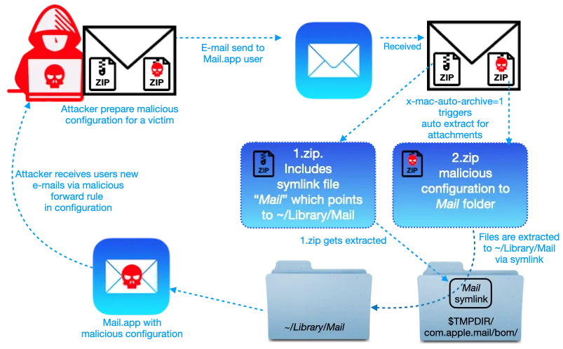
Other Examples: Zero-Click Zip
CVE-2020-9922
Affects iOS Mail App
Mail App parses file upon receipt, automatically unpacking them
Sending an email with a zip files automatically writes new mail rules and allows attacker to manipulate home files, exposing third party sensitive data
Leads to changes in victim configuration to allow for potential wormable exploit

Slide 7
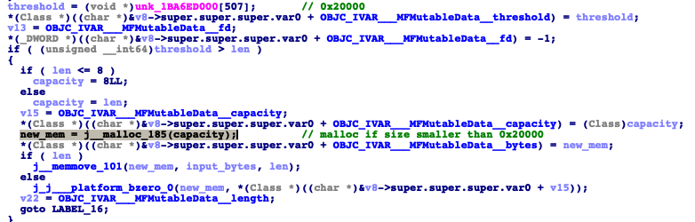
Other Examples: MailDemon
iOS attack first discovered in 2020
Works by sending crafted email to iOS default mail application. Only requires mail application to be open in the background
Vulnerability is triggered while processing the downloaded email, and the email never gets fully downloaded to device
Enables attacker to remotely take over the device

Slide 8
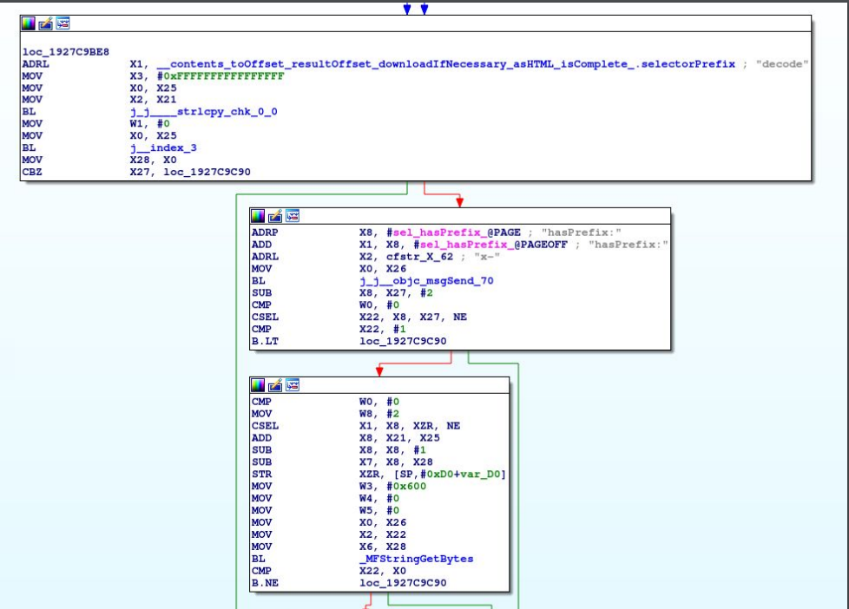
Other Examples: Project Zero
CVE-2019-8626
The Apple Mail app processes incoming messages without any user interaction
Sending MIME messages over SMTP with Python
Allows for potential denial of service

Slide 9
What should you know?
Why it happens?
Client code execution occurs before the email is presented to the user
Most anti-malware layers look at the attachment and not the full email
What can you do?
Select prevent-mode email security solution, avoid post-delivery tools
Verify your anti-malware emulates the email and not just the attachment

Slide 10
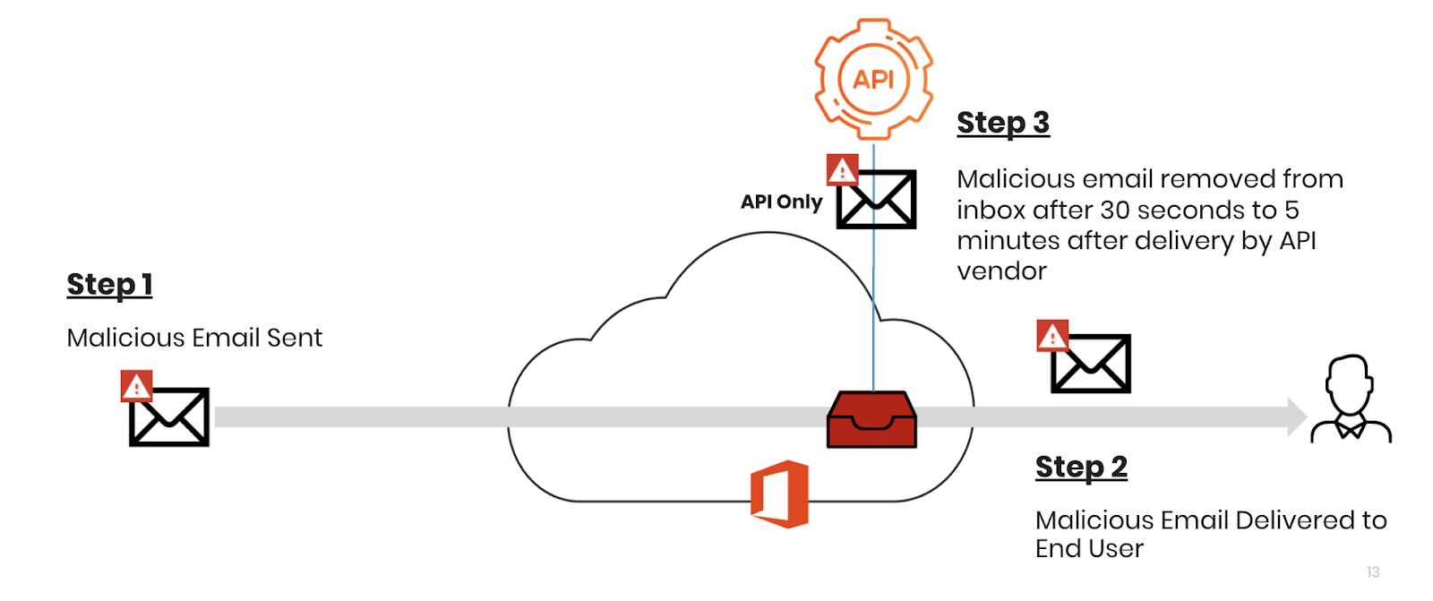
Inbox Incursions: What It Looks Like

Slide 11
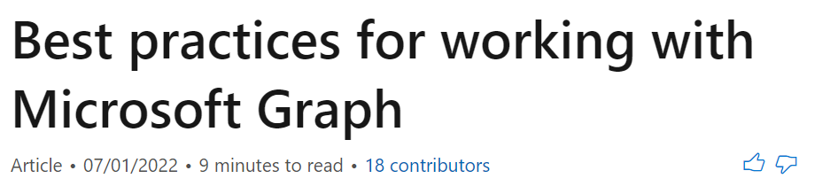

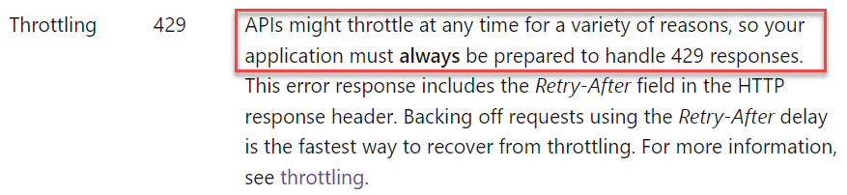
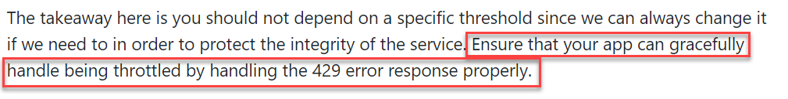
The Graph API

Slide 12
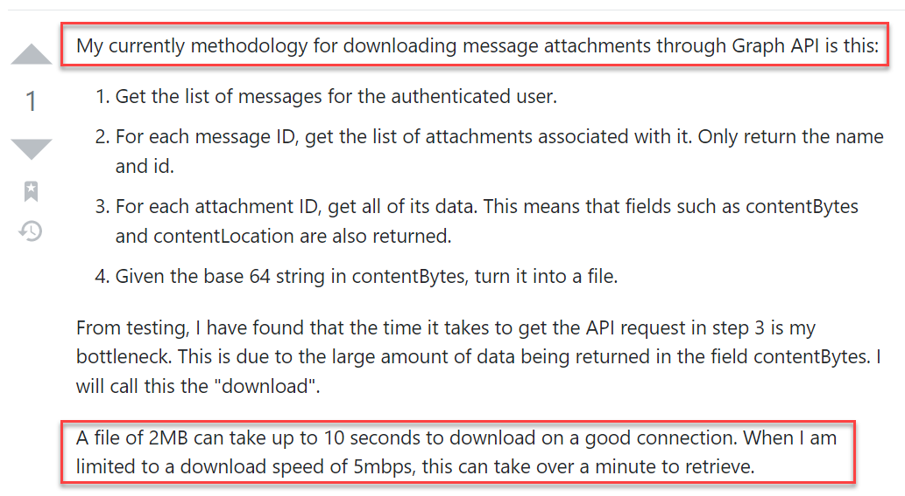
API Throttling
“A file of 2MB can take up to 10 seconds to download”

Slide 13
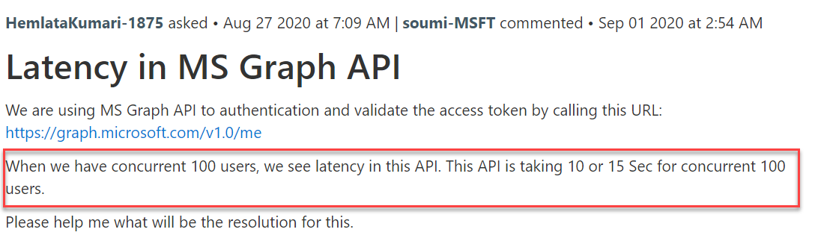
API Throttling
“When we have concurrent 100 users, we see latency in this API.”

Slide 14







Prevention First
BEC / anti-phishing
NLP & stylometry
Impersonation
Anti-spam
Notice/alert
Account compromise
Malware AV/Sandboxing
Encrypted Attachments
Malware Threat Extraction (CDR)
Link Reputation / Threat-Intel
Link Sandboxing
Link Click-time Protection
DLP
Encryption
Check Point’s Ethos = Block the attacks you can detect
We prevent threats BEFORE they reach the mailbox
Complete protection ideally suited for current and future threats
In 7 clicks and 30 seconds customer get inline protection
Post-
Delivery
Protection
(CESS)
Default Security
(EOP)
Advanced Threat Protection
(ATP)

Slide 15
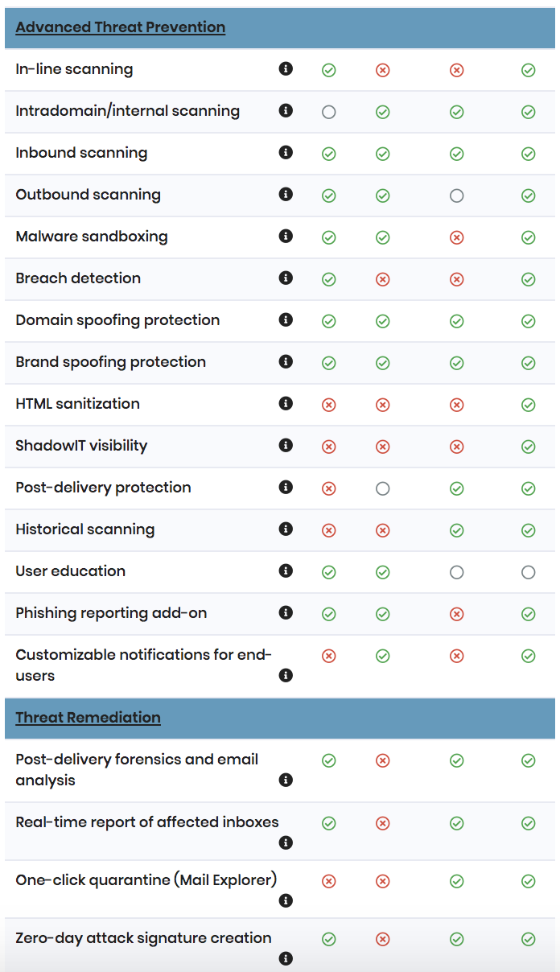
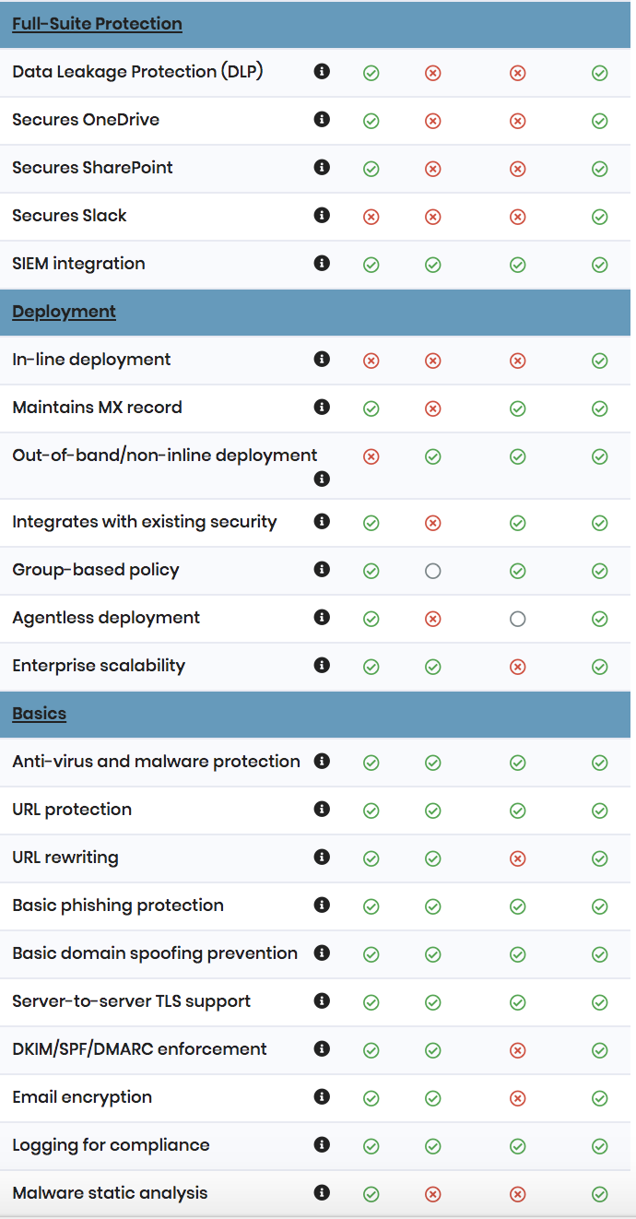
Complete Email Security vs A Point API Solution
Other API solution solve a subset of phishing
Prevent mode vs only post delivery enforcement
Best-in-class malware protection vs limited protection from malware
  No protection for encrypted attachments
Link click time protection, full URL emulation, rich threat-intel, DLP
  Vs No click-time protection
Multi-layered approach vs over reliance on NLP
  Not effective against BEC 3.0 attacks

Slide 16
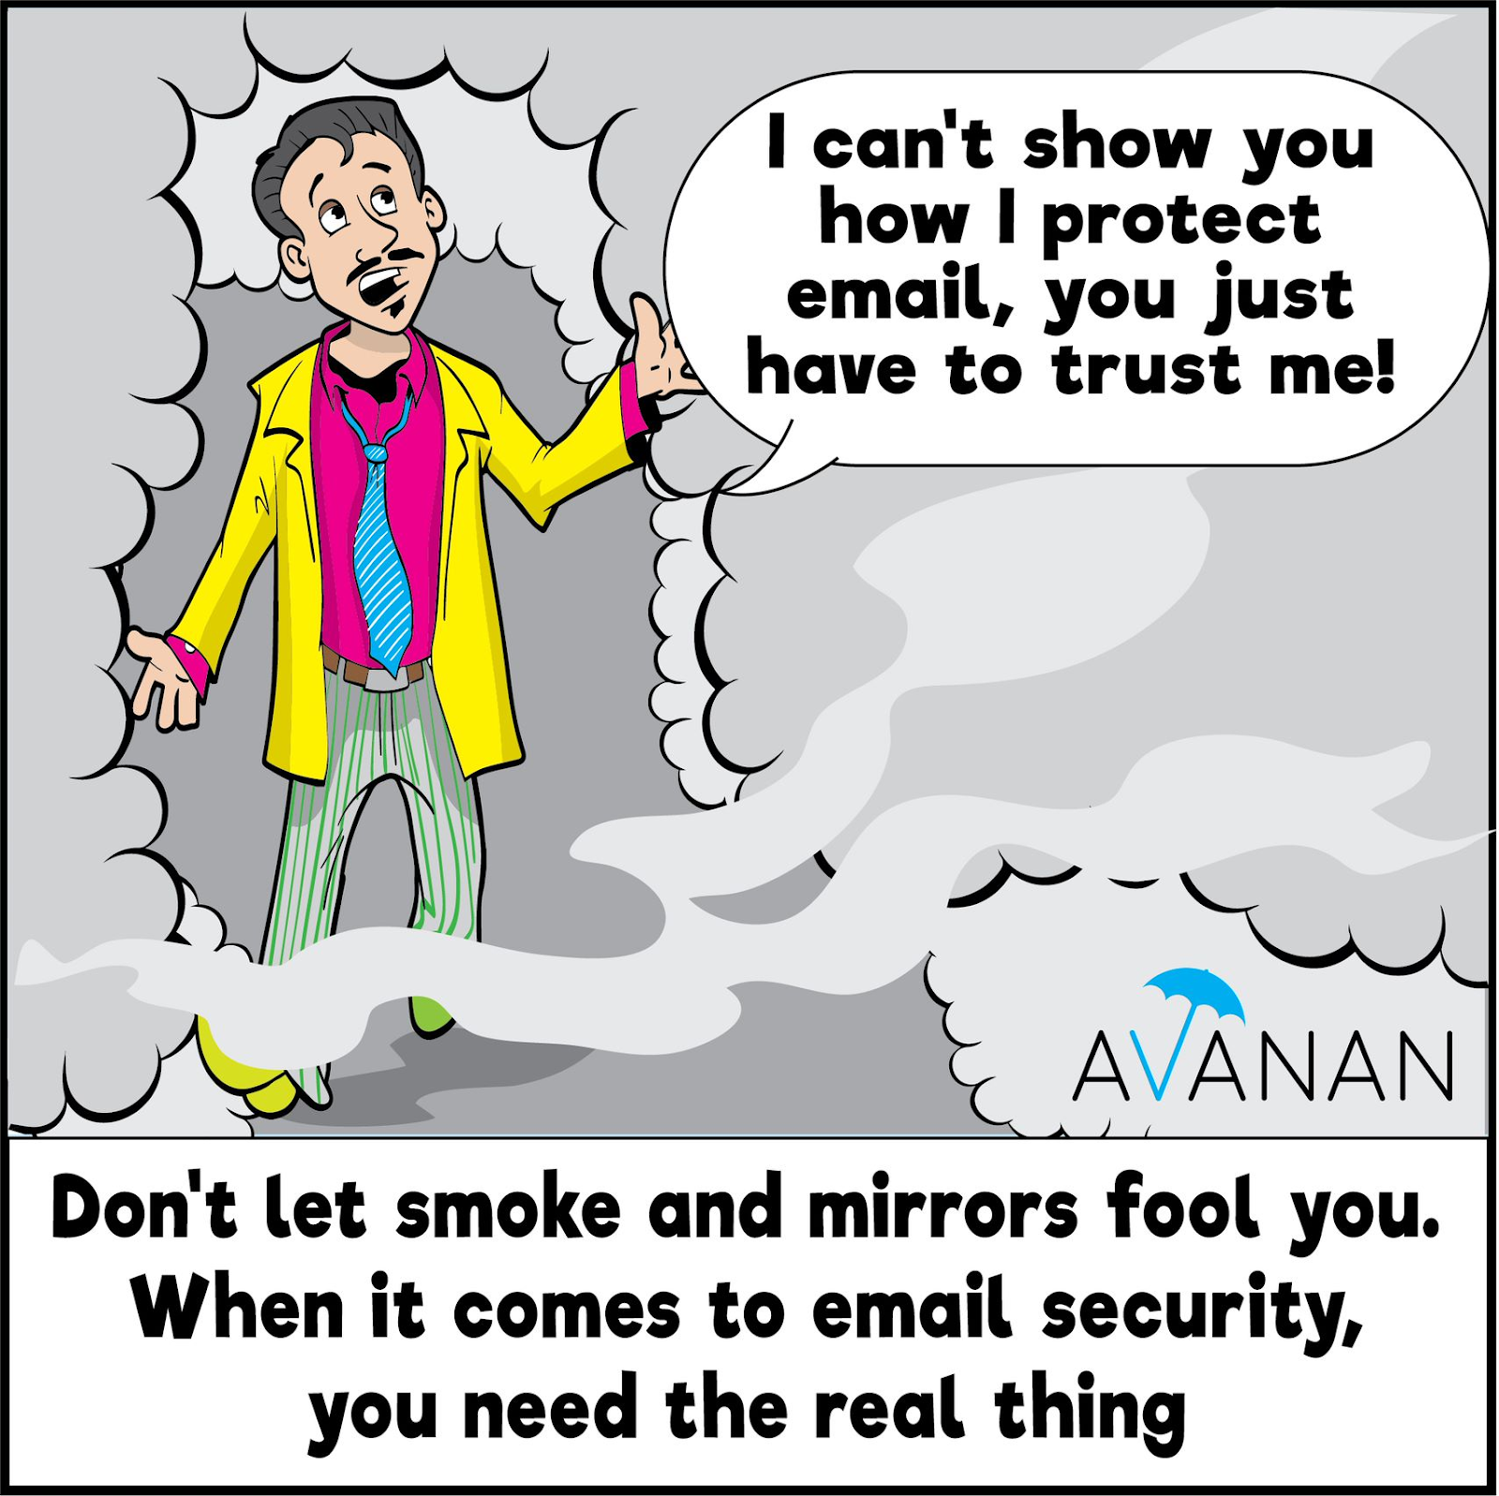
Takeaways
Zero-Click Attacks are incredibly threatening for email
Post-delivery remediation solutions are helpless against this attack form
Showcases need for full-fledged, prevention-first security

Slide 17
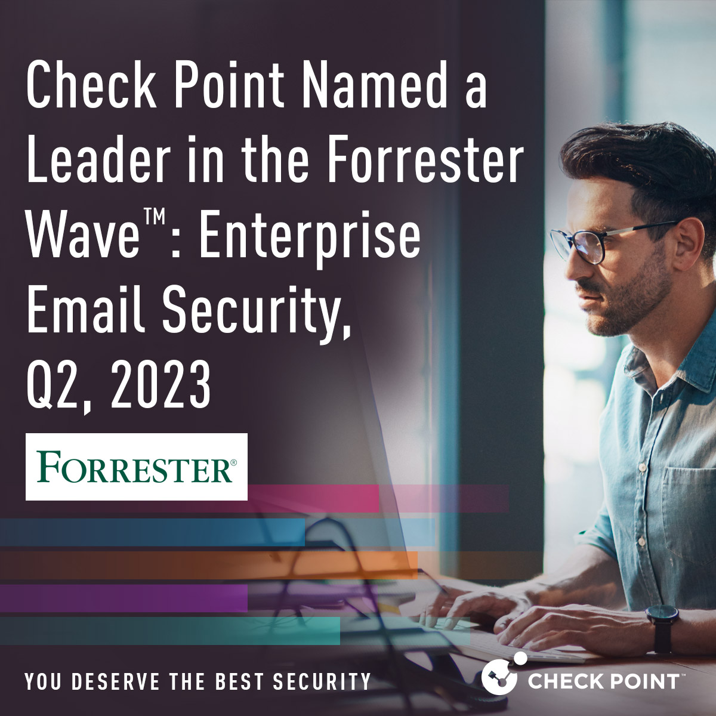
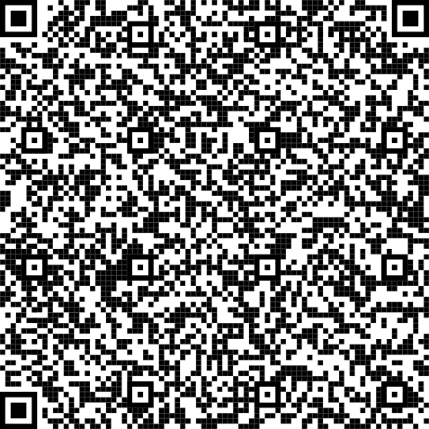
Read the
Report
Notes:
LINK: https://www.avanan.com/resources/reports/2023-forrester-wave?utm_campaign=Campaign%20-%20Forrester%20Wave%206%2F12%20-%20FY23&utm_source=Webinar&utm_medium=QR-Code&utm_content=Forrester-Wave-Report

Slide 18
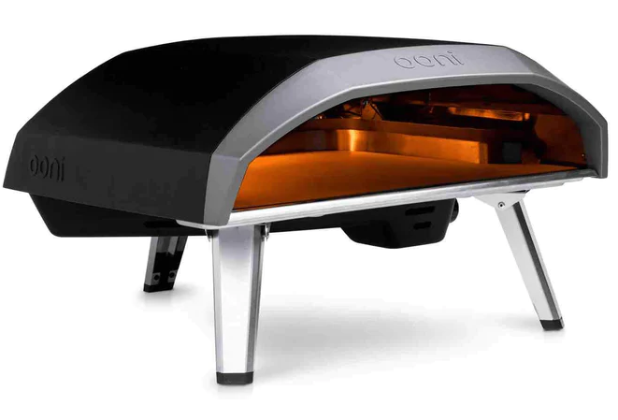
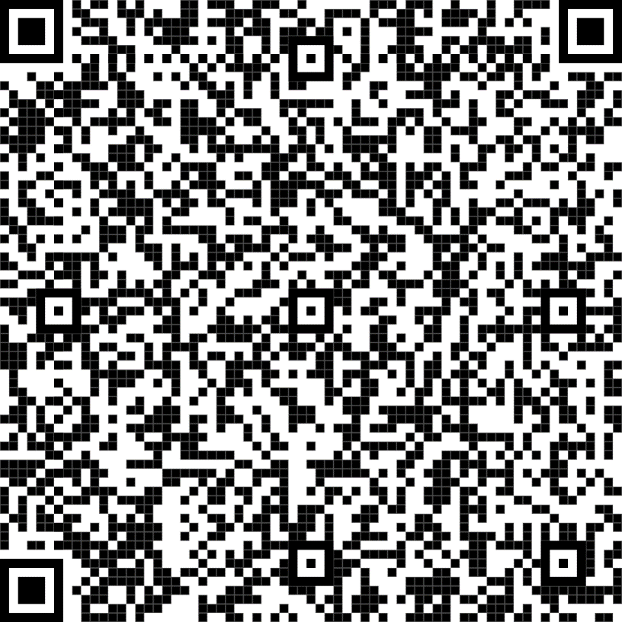

Try Harmony Email & Collaboration
Sign Up for a Free Trial
avanan.com/trial

Slide 19

Questions

