Slide 1
HARMONY EMAIL & COLLABORATION
Quick Start Guide for Solutions Granted
Speaker Name | Speaker Title Date
©2022 Check Point Software Technologies Ltd. 1

Slide 3
HEC Quick Start Guide
1
Register MSP Portal
Activate Account
Customize Branding
2
Onboard Tenant
Start SaaS Apps
Learning Mode
Best Practices
3
Proof of Concept
Milestones
Security Checkup Report
4
Convert License
License Tiers
Add-On Services
[Internal Use] for Check Point employees
©2022 Check Point Software Technologies Ltd.
3

Slide 4
HARMONY EMAIL & COLLABORATION
REGISTER MSP PORTAL
[Internal Use] for Check Point employees
©2022 Check Point Software Technologies Ltd. 4

Slide 5
Platform Hierarchy
Multitenant MSP Portal
Resells to Child MSP’s
Can sell Direct to Clients
Master MSP
Multitenant MSP Portal
Sells Direct to Clients
Child MSP
Consumes Harmony Email and Collaboration Service
User Account Access to Tenant Dashboard
Tenant

Slide 6
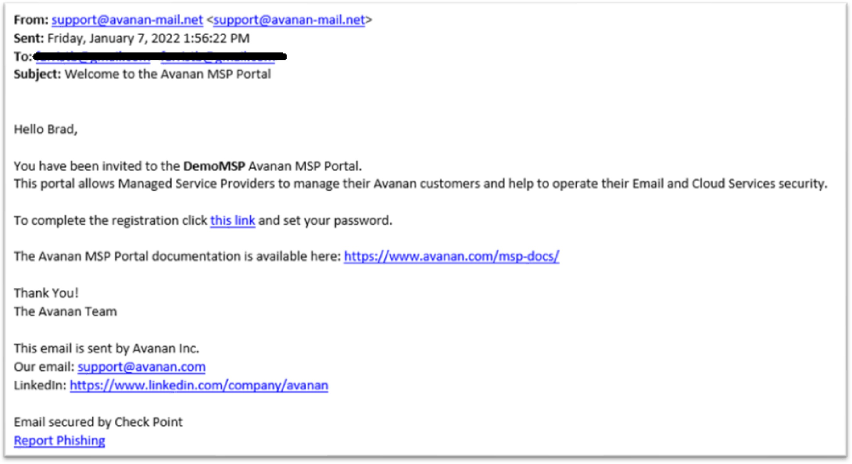
Complete MSP Portal Registration
Bookmark https://portal.avanan.net/

Slide 7
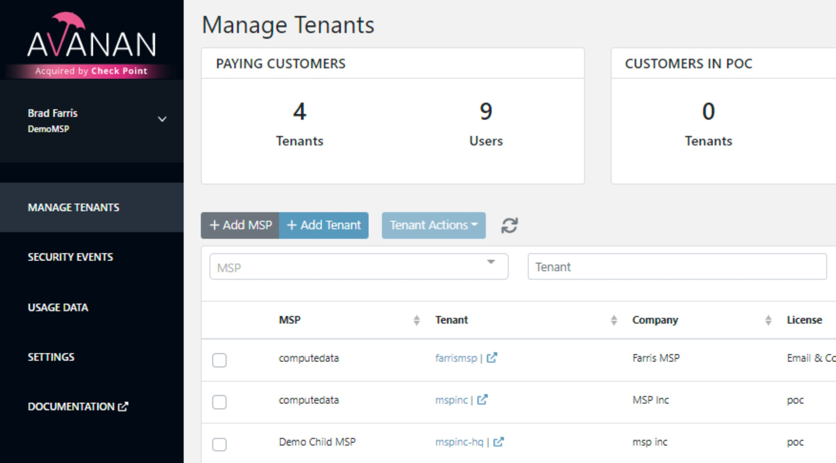
MSP Dashboard Navigation
Manage Tenants
Security Events
Settings
Documentation

Slide 8
Manage Tenants
Manage paying customers, POC’s, renewals, and issues
Add or Delete Tenants (clients) on the platform
Upload a custom logo displayed in the MSP portal
Choose license types and Add-on services (IRaaS)

Slide 9
Security Events
Multi-tenant visibility into the latest events and threats
Search by tenant name or event severity
Click-through to Tenant Events view and take actions
•

Slide 10
Settings
Configure Authentication Settings
Manage MSP internal users
Upload a custom logo for the MSP portal

Slide 11
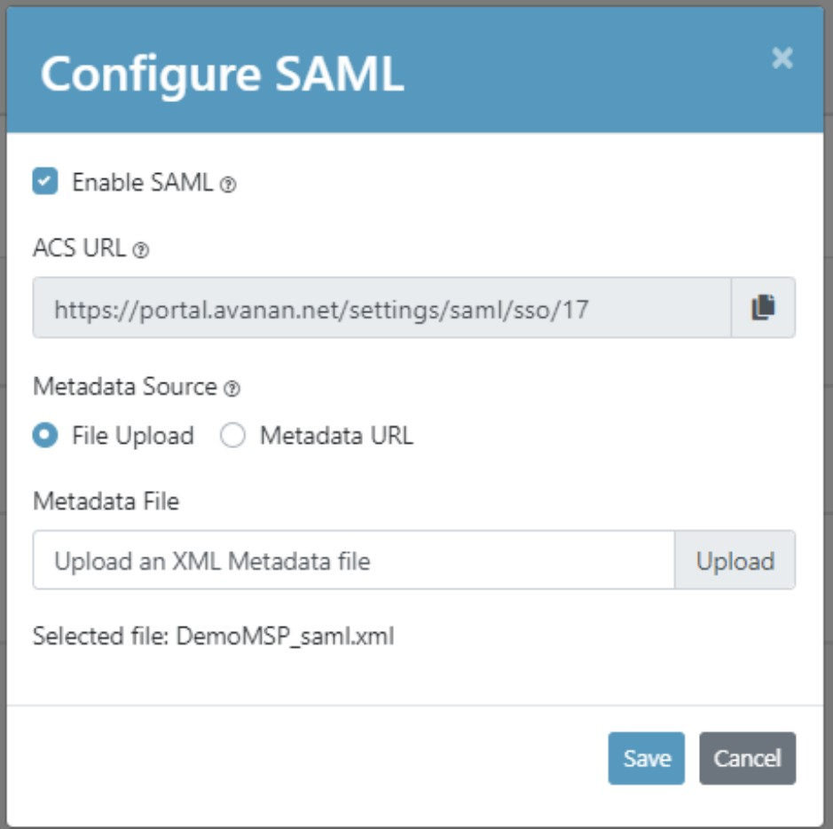
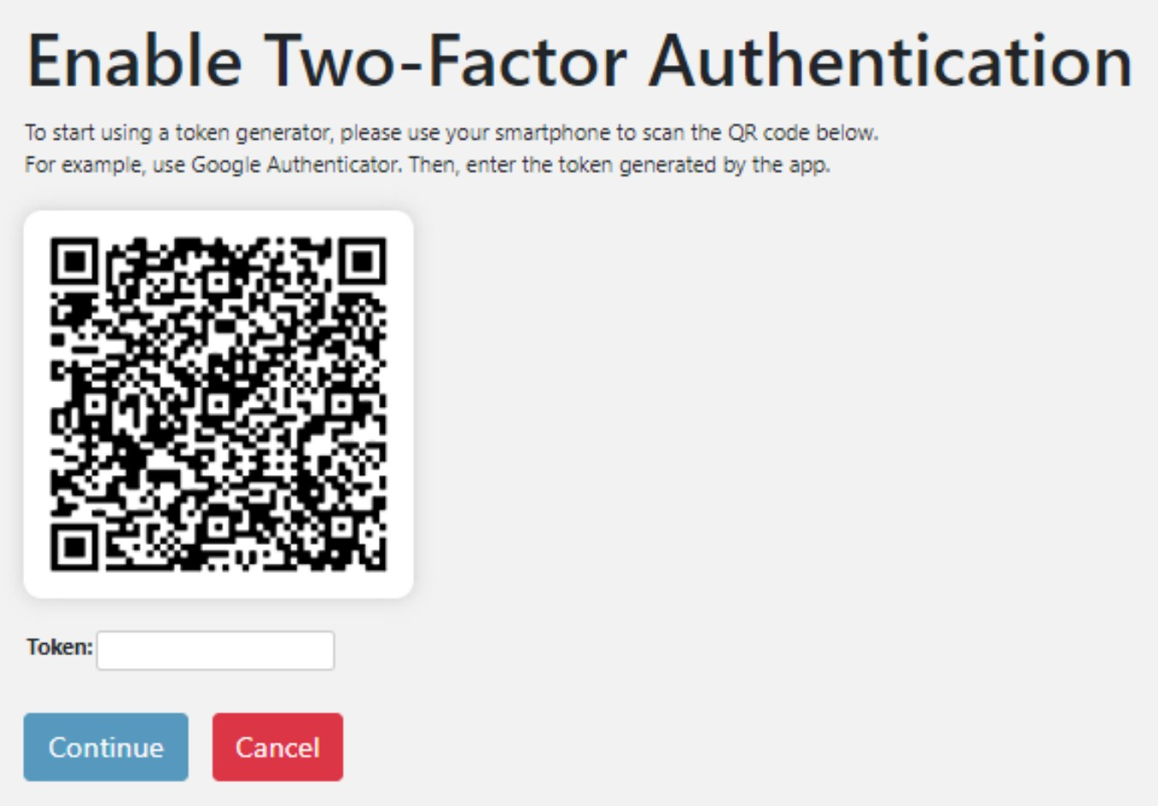
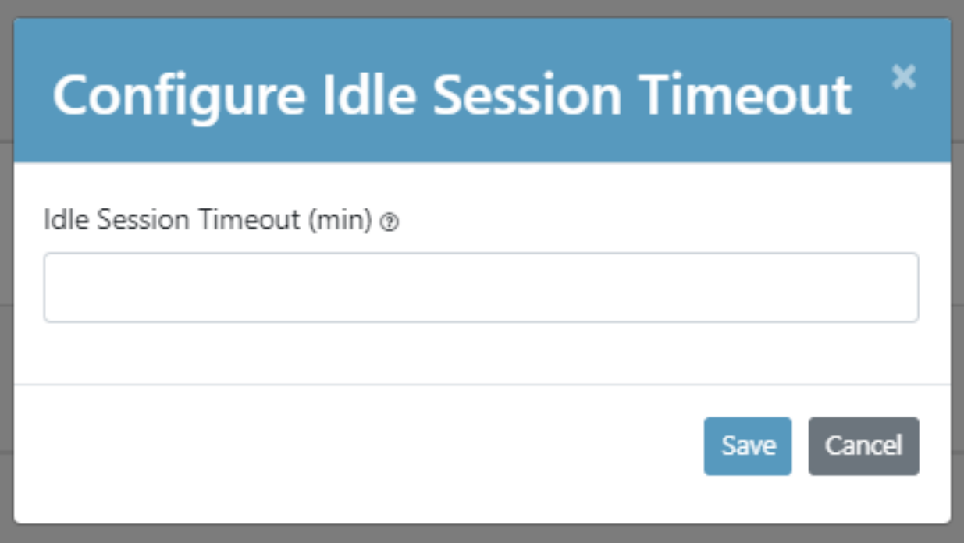
Authentication Settings
Configure SAML
Configure MFA
Configure Idle Session Timeout

Slide 12
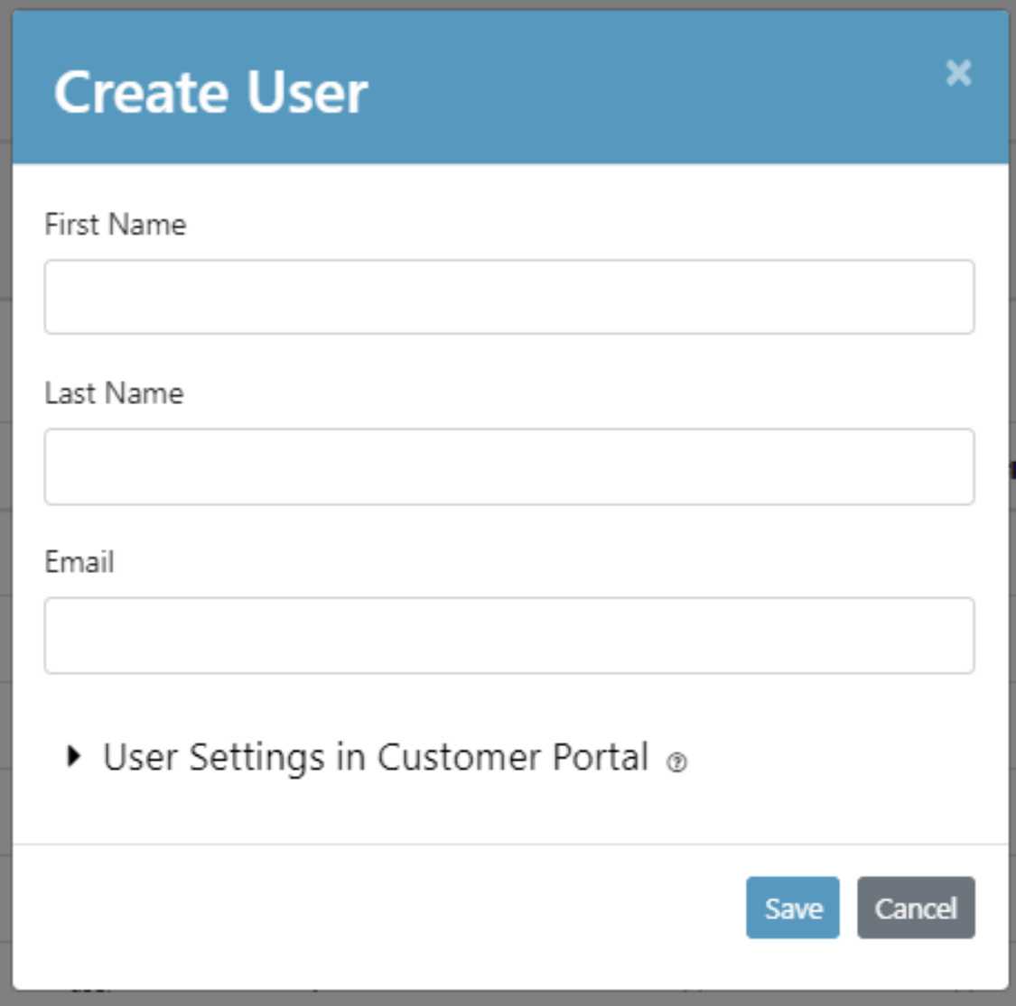
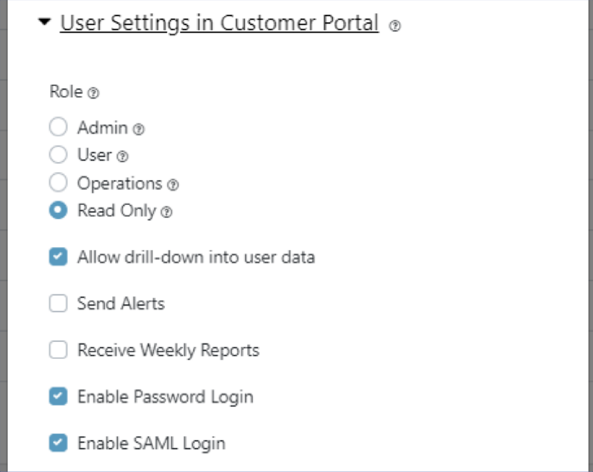
User Management
Add Users and manage existing users
Select the role and level of permissions each user should have

Slide 13
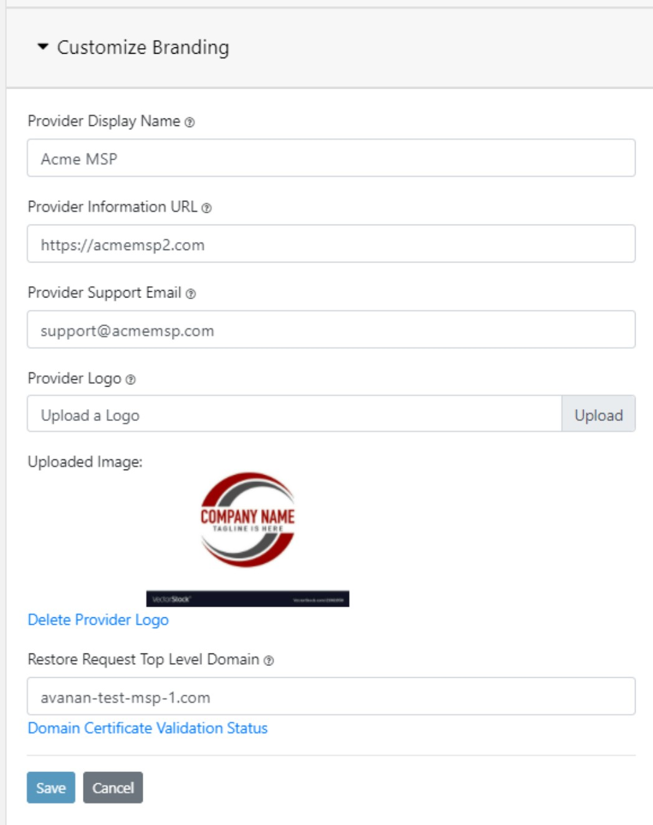
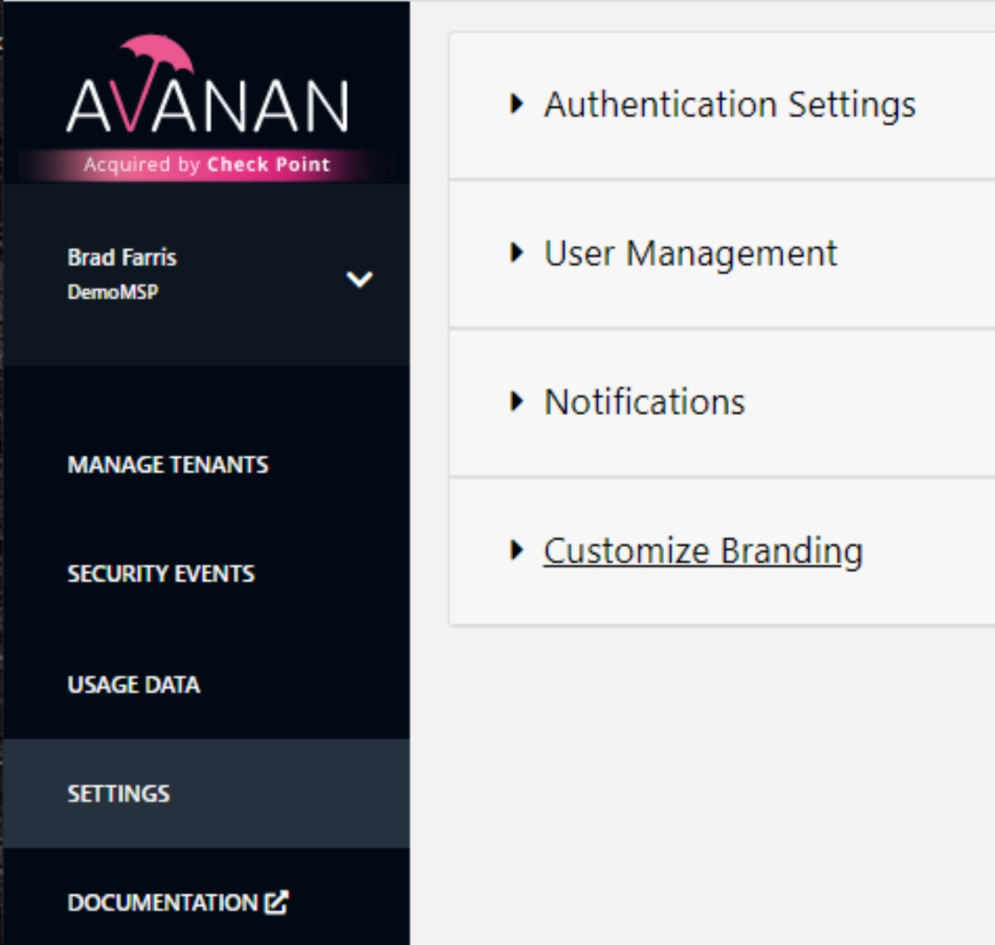
Customize Branding
Upload provider logo displayed in the top left of the MSP portal

Slide 14
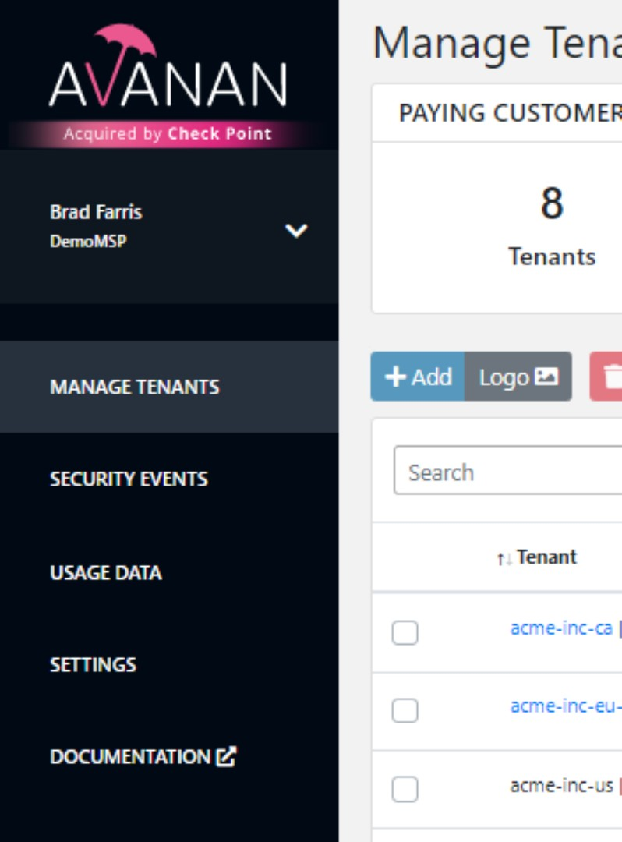
Documentation
Links out to documentation specific to the MSP portal
https://www.avanan.com/msp-docs/index
Tenant management, authentication, settings, API and licensing

Slide 15
HARMONY EMAIL & COLLABORATION
TENANT ONBOARDING
©2022 Check Point Software Technologies Ltd. 15

Slide 16
General Onboarding
Onboarding a new customer is a crucial point in the sales process.
Your goal is to provide a simple process for getting started with the solution.
Onboarding high level workflow:
Add a new MSP or new Tenant and select a Harmony Email and Office license.
Setup email and SaaS applications according to the recommended deployment method.
Configure the policy and allow/block lists in learning mode.
Change enforcement mode to best practice – In-line Prevention.

Slide 17
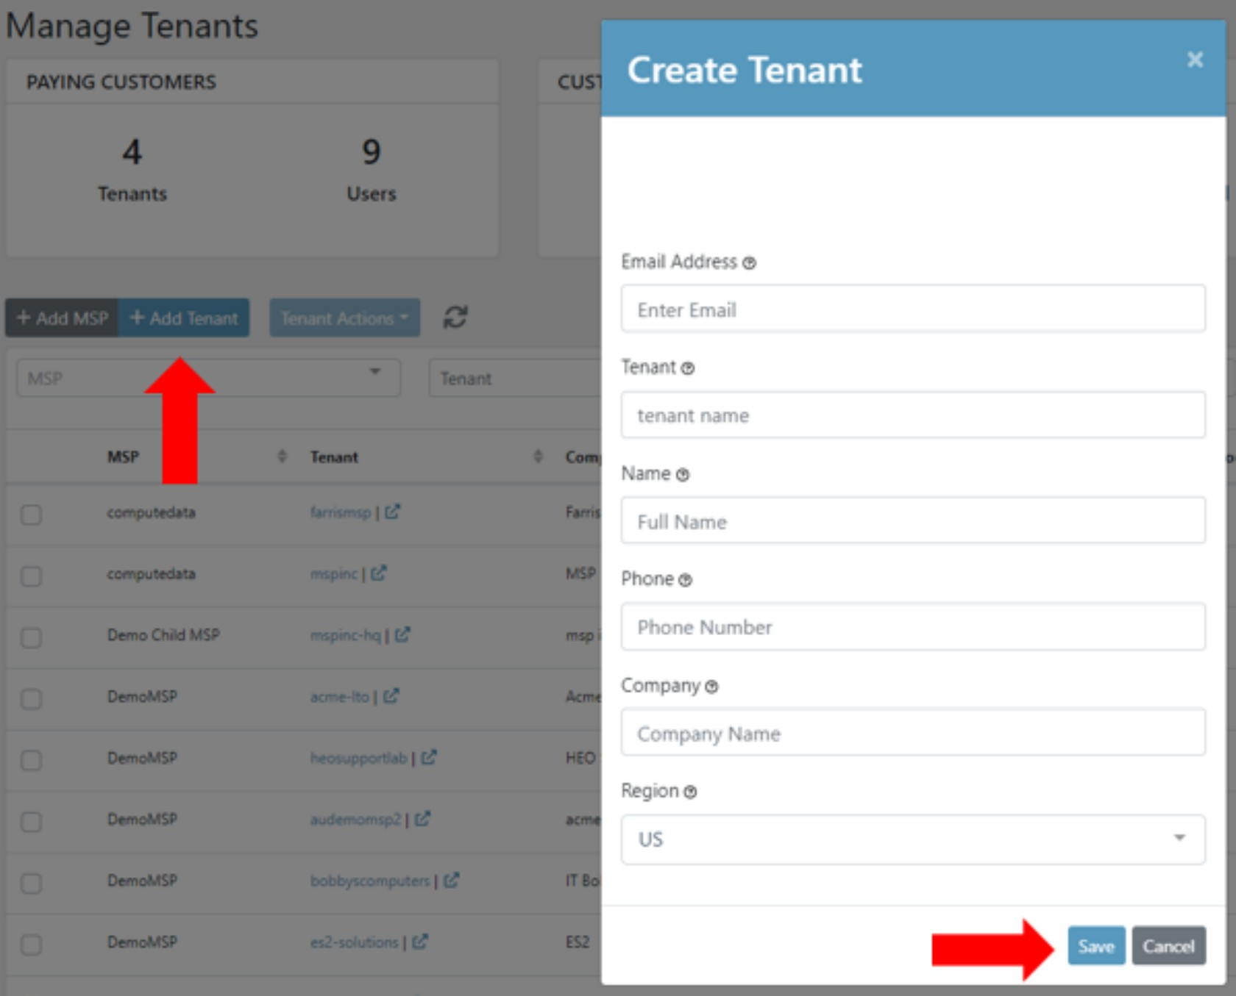
Create New Tenant
Click the Add Tenant button
Fill in tenant contact information and click Save.
The tenant will be in a creation status for about 3- 5 minutes and then become active.
Once tenant is active click the tenant's name to begin the setup process in the next slide.
Disable pop-up and ad blockers before starting SaaS applications to allow new tab to open.

Slide 18
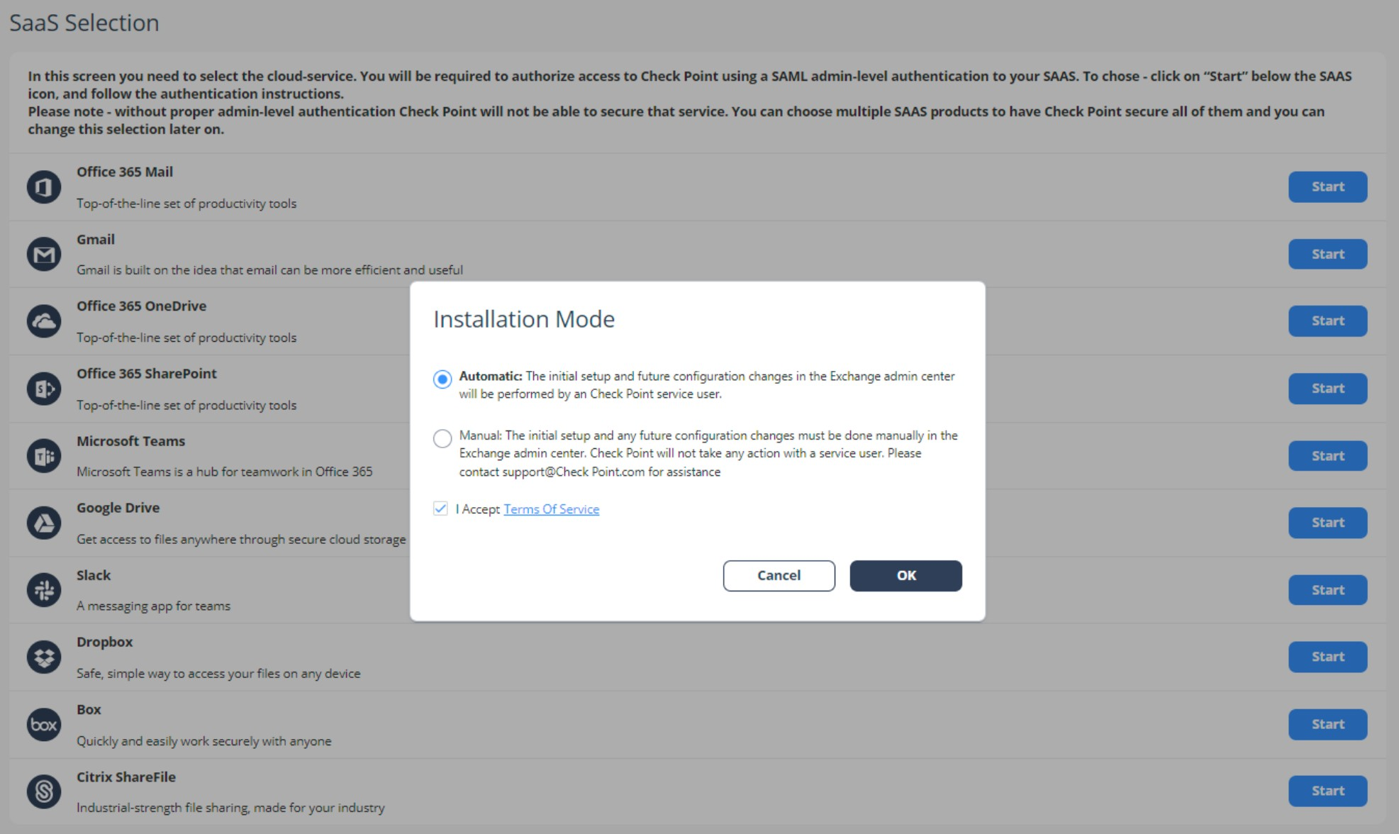
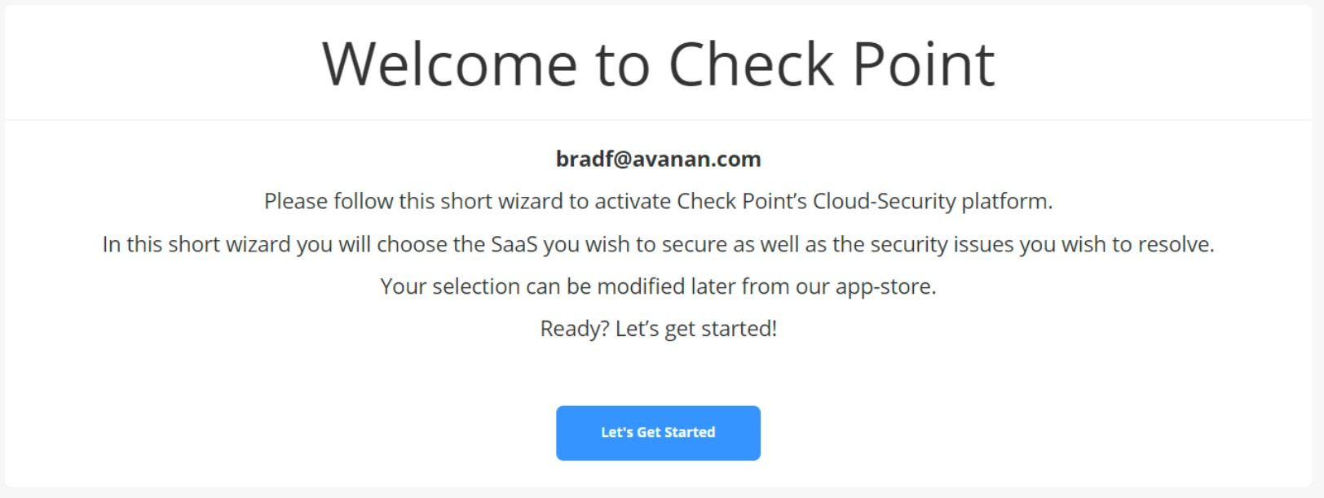
SaaS Application Integration
Click on the ‘Lets Get Started’ button on the Welcome page
Click the Start for ‘Office 365 Mail’ on Connect for connecting to Microsoft 365.
Choose automatic (recommended) or manual and login to your Microsoft 365 admin account to authorize the connection.

Slide 19
Fast and Seamless Onboarding
7 Clicks 30 Seconds

Slide 20
Post-Onboarding Learning Mode
Administrators are alerted about detections of Malware, DLP, Shadow IT and anomalies
Phishing and Spam detections are temporarily disabled and are automatically enabled once Learning Mode is completed
Anti-Phishing analysis of all emails will return clean with an indicator that they were inspected during Learning Mode
A banner is added to the dashboard and a progress indicator appears under the Phishing dashboard chart
The progress can be tracked in detail under Audit -> System Tasks
This analysis takes minutes in small environments and up to one day in very large environments.

Slide 21
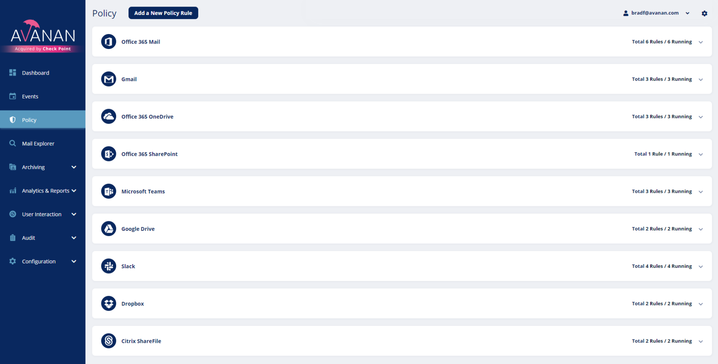
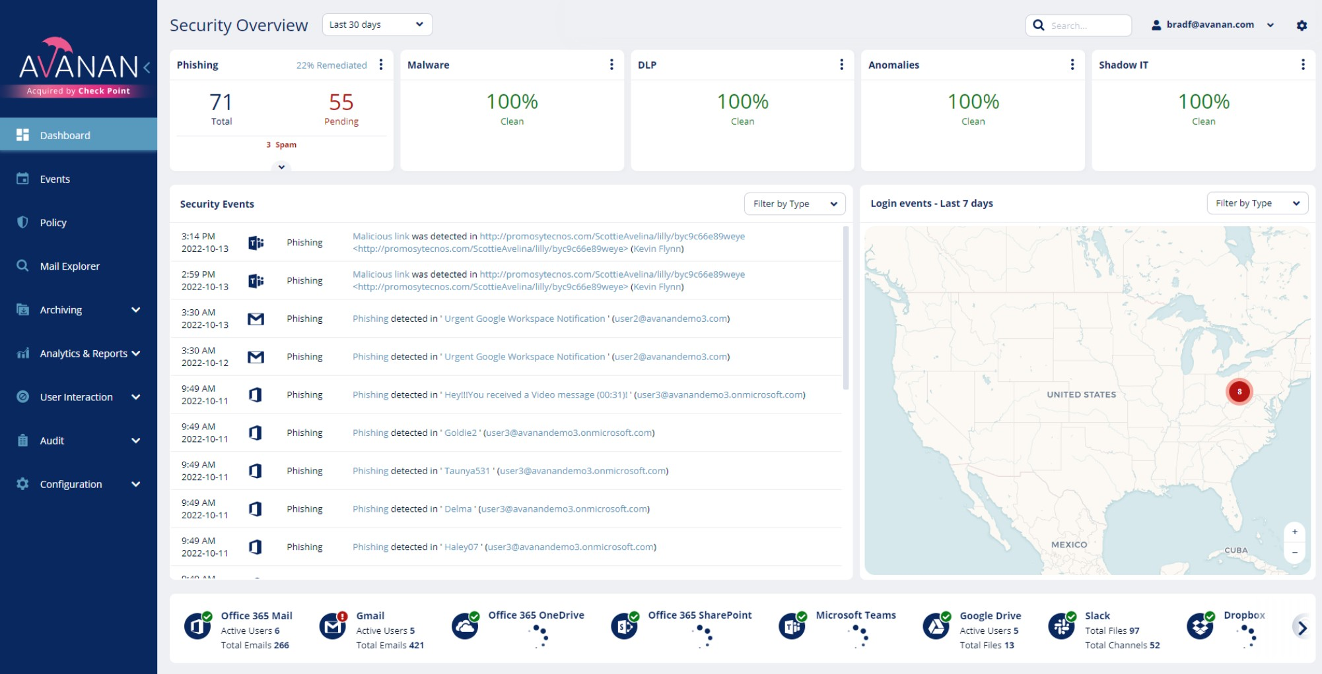
Post Onboarding Best Practices
Emails are inspected by Harmony Email and Office and routed to mail recipients according to the configured policies and workflows.
The recommended configuration to start with is Monitoring mode, which means that the enforcement is set to passively Detect threats. This is the default configuration applied after product onboarding.
Detection logs are generated and visible in the logs tab and overview tab.

Slide 22
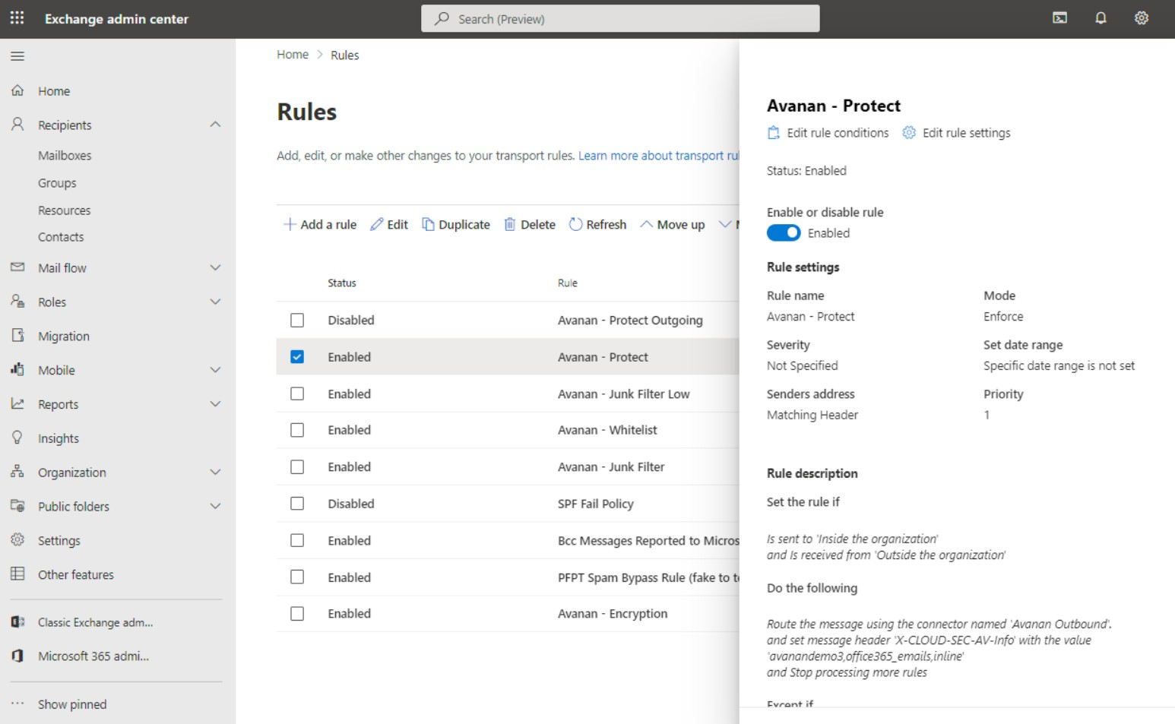
Moving to Inline Protection
Select “Protect (Inline)” and select the scope of users you wish to protect. By default, all users and groups will be protected.
Alternatively, you may also choose to protect only specific users or members of a security group.
HEC will leverage the Graph API integration to make the appropriate changes in Exchange. This takes a few moments
In the Exchange Admin Center, the scope of protected users will be reflected in the “Avanan - Protect” mail flow rule

Slide 23
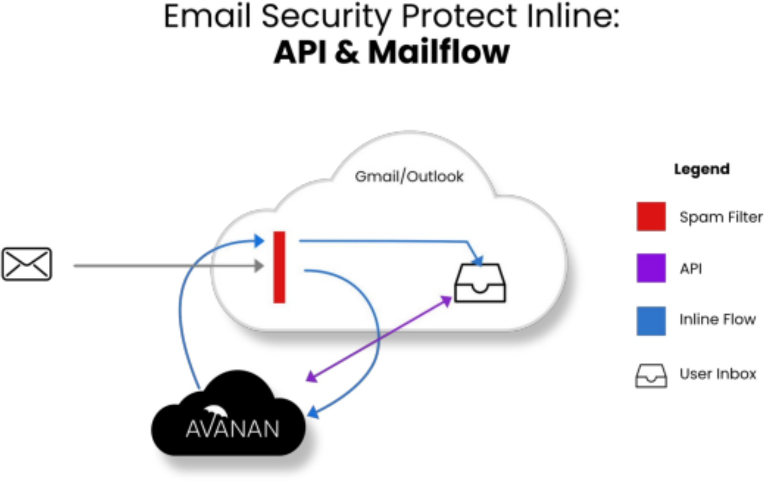
Moving to Inline Protection
Email sent to users protected inline will be processed twice.
The first time, the emails are sent to Avanan for scanning by SmartPhish. This is done by the “Avanan - Protect” mail flow rule.
Emails that are not quarantined will be sent back and processed by the “Avanan - Whitelist” or “Avanan - Junk Filter” mail flow rules based on the original SCL as determined by Office 365.
Please refer to this guide to stop inline protection

Slide 24
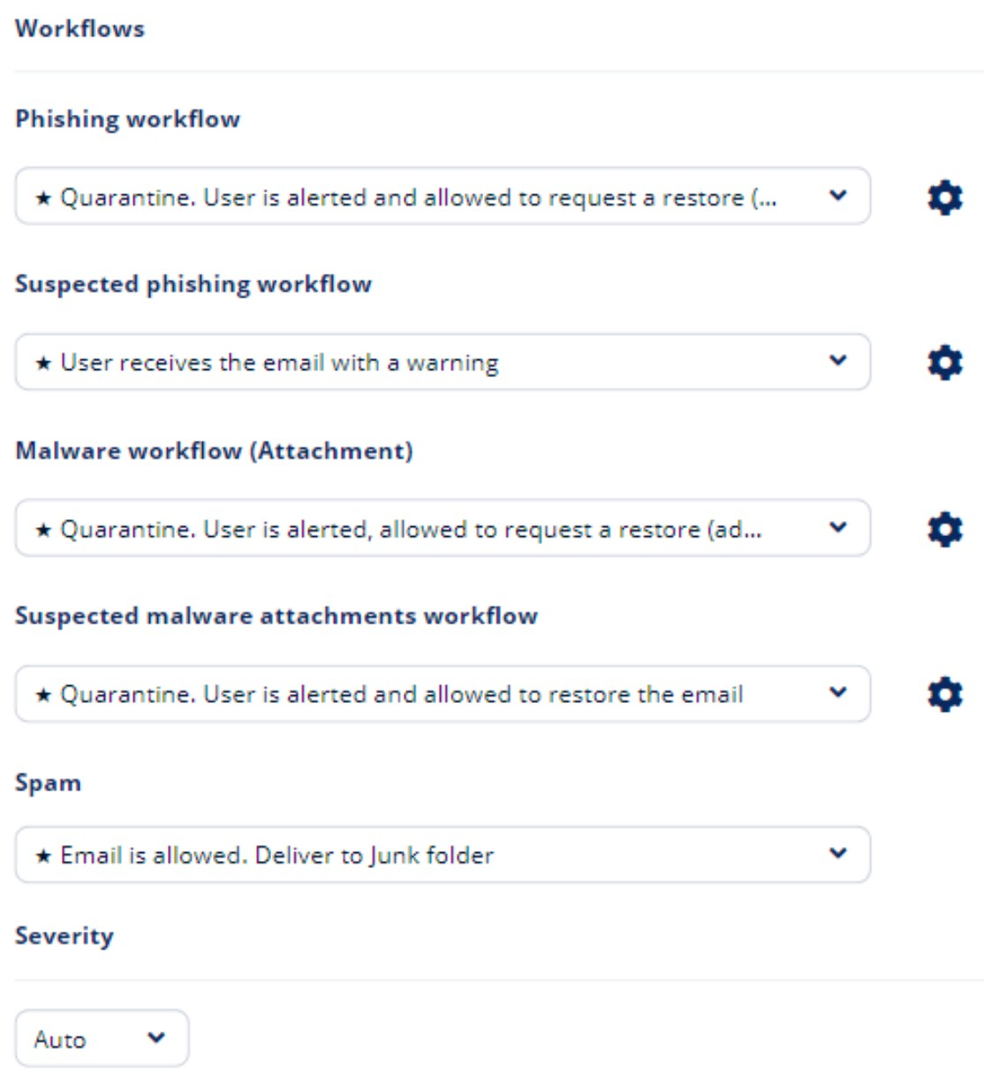
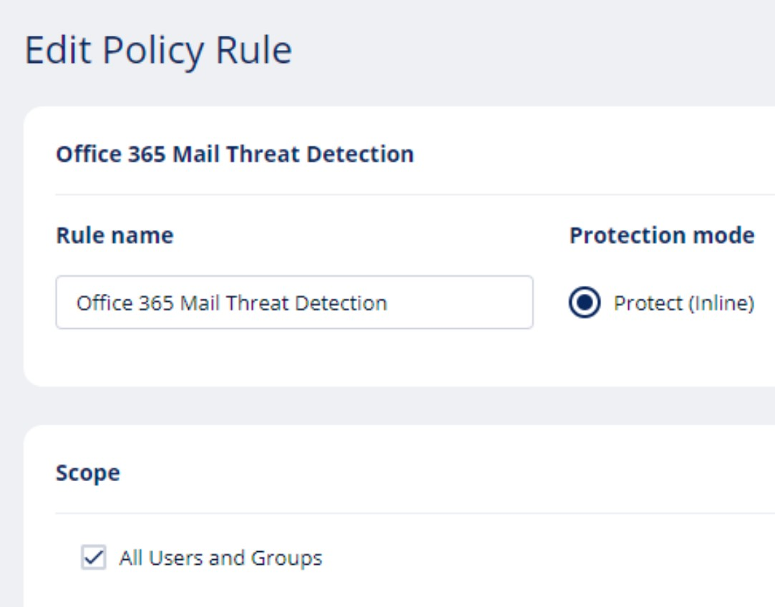
Defining User Experience
Cloud SaaS App
Ex. M365 EOP policy to send MS quarantine or to Junk folder
Security Engine
Global customization of how filter it works on a per tenant basis
Harmony Policy
Completely customizable workflows per SaaS app, targeting users and groups, controls alerts to users and admins

Slide 25
Important information
It is very important to understand each customer’s configuration to know what deployment is needed and to troubleshoot issues.
Protect customers who have complex or hybrid email setups.
Some mailboxes are on premises, others are cloud based.
Many hybrid setups are configured using domain-based connectors
The email is first routed to the cloud and from there to the on-premises servers.

Slide 26
HARMONY EMAIL & COLLABORATION
PROOF OF CONCEPT
©2022 Check Point Software Technologies Ltd. 26

Slide 27
General Proof of Concept
Running a proof of concept with a new customer shows value in protection.
Your goal is to qualify risk of attack and provide examples of real threats.
Proof Of Concept Guidelines:
Every new Tenant by default starts with a POC license that is active for 14 days.
Setup all relevant email and SaaS applications known and identified by Shadow IT.
Configure the policy and allow/block lists in learning mode.
Change enforcement mode to best practice – In-line Prevention.

Slide 28
14 Day Trial Process
Day 1
Day 7
Trial Kick Off
Initial Setup
Configure SaaS and Security Stack
Define Use Cases
Perform Initial Scan
Monitor Only Mode
15 minutes
Review Results in Prevent Mode
Analysis of Prevent Mode
Review Workflow
Validate End User Experience
Best Practice Review
Q&A
30 minutes
Review Results
Analysis of Results
Malware
Phishing
Etc.
Move to Protection Mode (up to 5 users)
Q&A
30 minutes
Trial Wrap Up
Live Review Trial Results
Provide Executive Summary Report
Q&A
30 minutes
Day 3
Day 14

Slide 29
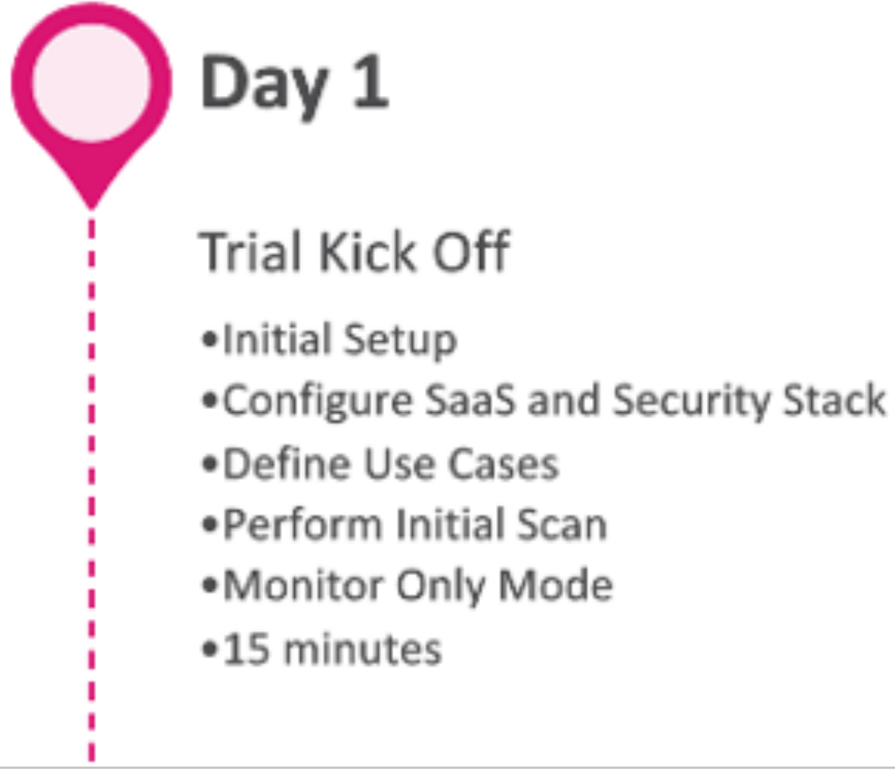
Day 1 Checklist
Confirm use-cases (Phishing, Malware and or DLP)
Review with the customer the overall trial process and requirements before the install (Global Admin, Hybrid setup, MFA)
Perform installation (automatic or manual)
Set the expectation we will see data in the portal over the next 48 hours in monitoring mode and will provide full training once we have a full data set.
Review goals for the 1st trial review session
Review requirements to move users to an in-line protection policy (prevention by quarantine)
Schedule the first review session for 48 to 72 hours

Slide 30
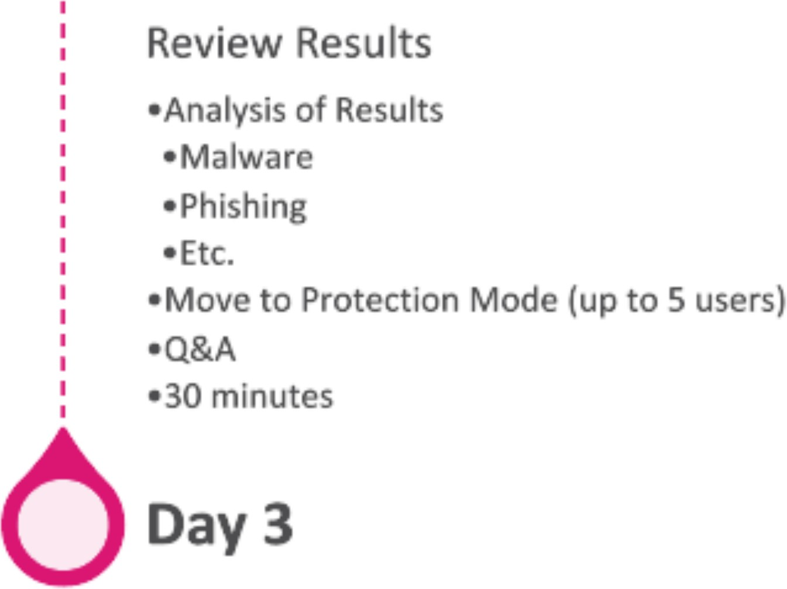
Day 3 Checklist
Review with the customer the overall trial process and current step
Review high level results x users scanned x emails scanned
Review Phishing results and training on phishing events workflow (Confirmed/Suspicions/Spam).
Training on the phishing email profile and all tools (advanced buttons, Allow List, Block List), tune false positives as needed.
Enable in-line for up to 5 users (Set quarantine approvers, send test phishing emails as needed)
Review quarantine workflow and restore process
Schedule follow up Review Session 2

Slide 31
Day 7 Checklist
Review with the customer the overall trial process and current step
Review quarantine workflow and results.
Adjust policies as needed.
Ensure all false positives are removed
Discuss training on advanced query building.
Review Quotes
Schedule Final Review

Slide 32
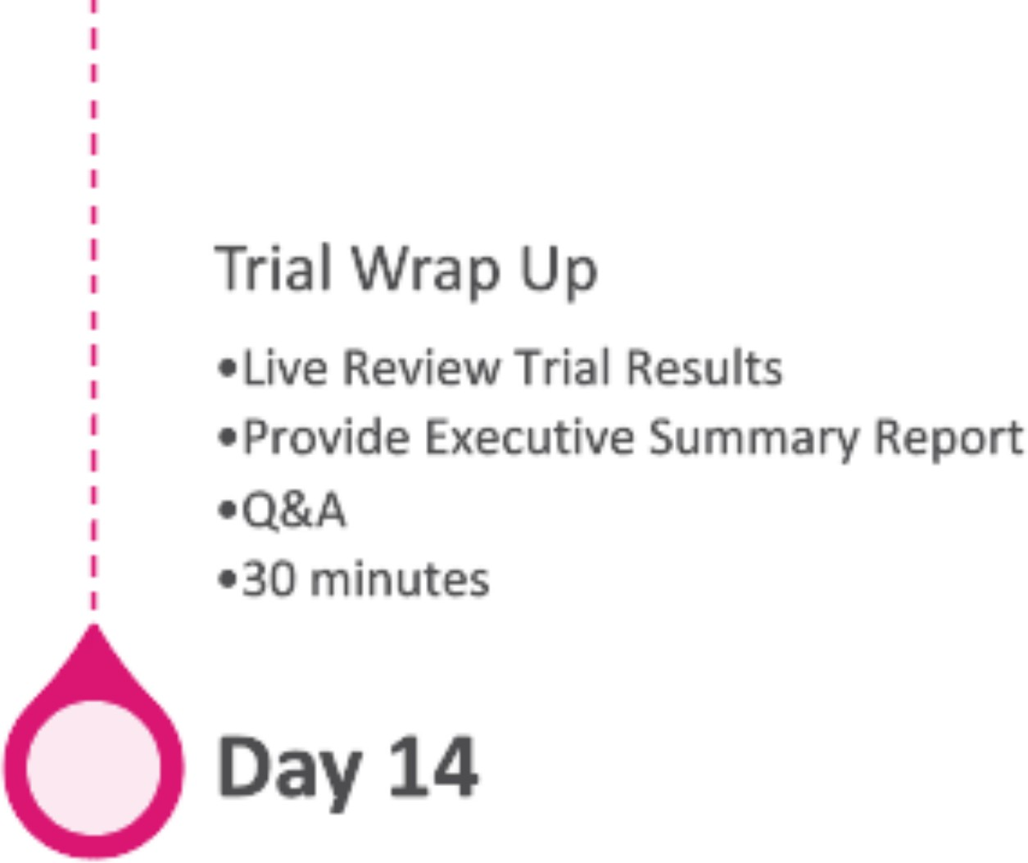
Day 14 Checklist
Review with the customer the overall trial process and current step
Review final counts of phishing and review the summary report
Reinforce the value of advanced threat protection
Ensure technical win
Close the deal!

Slide 33
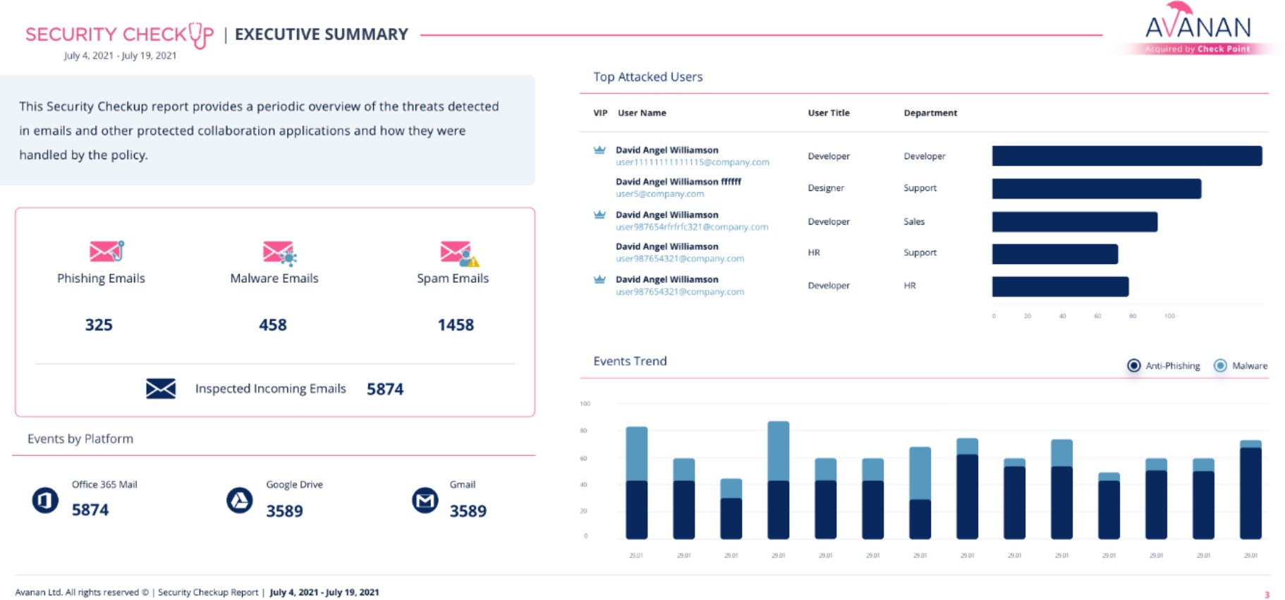
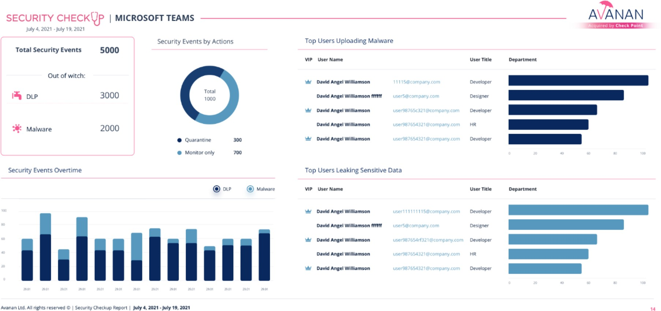
Security Checkup Report
Detailed graphic report summarizing the threats the organization faced through emails, file sharing and messaging applications
Provides a clear view to how the system handled these threats and who are the most attacked users
Sent every week to all configured recipients
Administrators can generate on demand through Analytics & Reports -> Security Checkup

Slide 34
HARMONY EMAIL & COLLABORATION
LICENSE CONVERSION
[Internal Use] for Check Point employees
©2022 Check Point Software Technologies Ltd. 34

Slide 35
MSP License Options
Offer additional pricing model, such as price tiers and pay-as-you-go
Total overall usage is automatically counted daily and billed monthly.
MSP License Options:
Protect - Anti-Phishing protection, including known malware and URL inspection, for Office 365 and G Suite incoming and internal emails, as well as collaboration applications (OneDrive, Google Drive, Teams, Slack, and more)
Advanced - Anti-Phishing, including URL inspection and file sandboxing and sanitization (CDR), for incoming and internal Office 365 and Google Suite emails, as well as collaboration applications (OneDrive, Google Drive, Teams, Slack and more)
Complete - Anti-Phishing, Anti-Malware and Data Loss Prevention (DLP) protection for incoming, internal and outgoing Office 365 and Google Suite emails, as well as collaboration applications (OneDrive, Google Drive, Teams, Slack and more)
https://catalog.checkpoint.com

Slide 36
MSP License Add-Ons
IRaaS
Available 24/7 including weekends or during off-hours
Analyst spends between 15-25% of their time dealing with email threats
Workflows
User Reported Suspicious Emails
Releasing from quarantine
Creating whitelists
Creating blacklists
Marking as phishing
Cross-customer mitigation
Archiving
Meet regulatory compliance standards, restore lost emails and for other legal use cases
Store all incoming, outgoing and internal emails for 7 years
Administrators can filter through archived emails by several conditions and export anywhere
Every action administrators perform on the email archive is fully audited

Slide 37
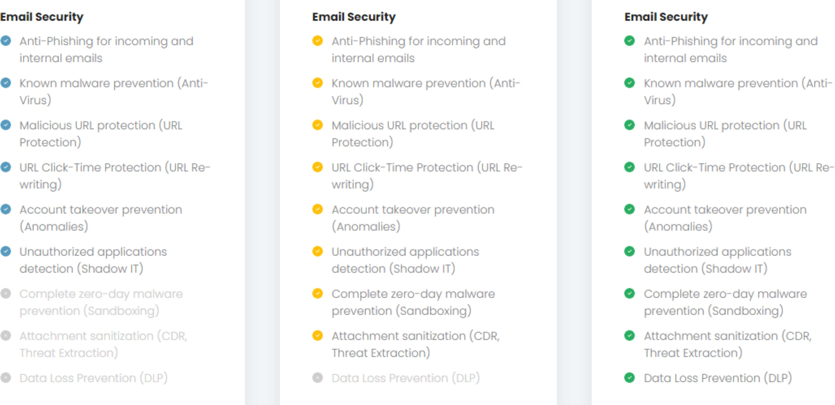
Email Security License Tiers
Protect Advanced
Complete

Slide 38
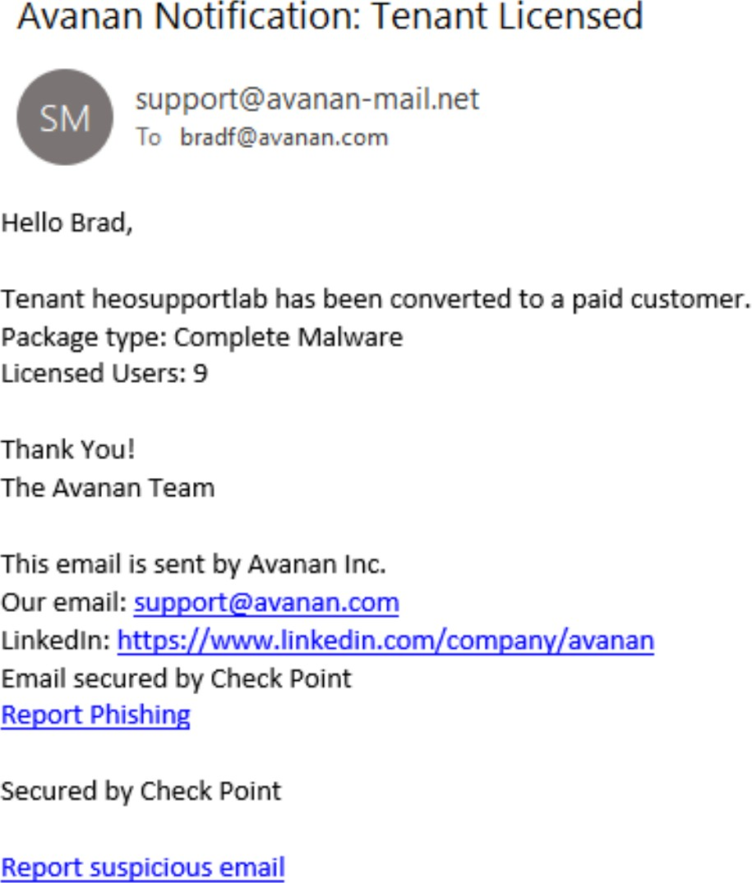
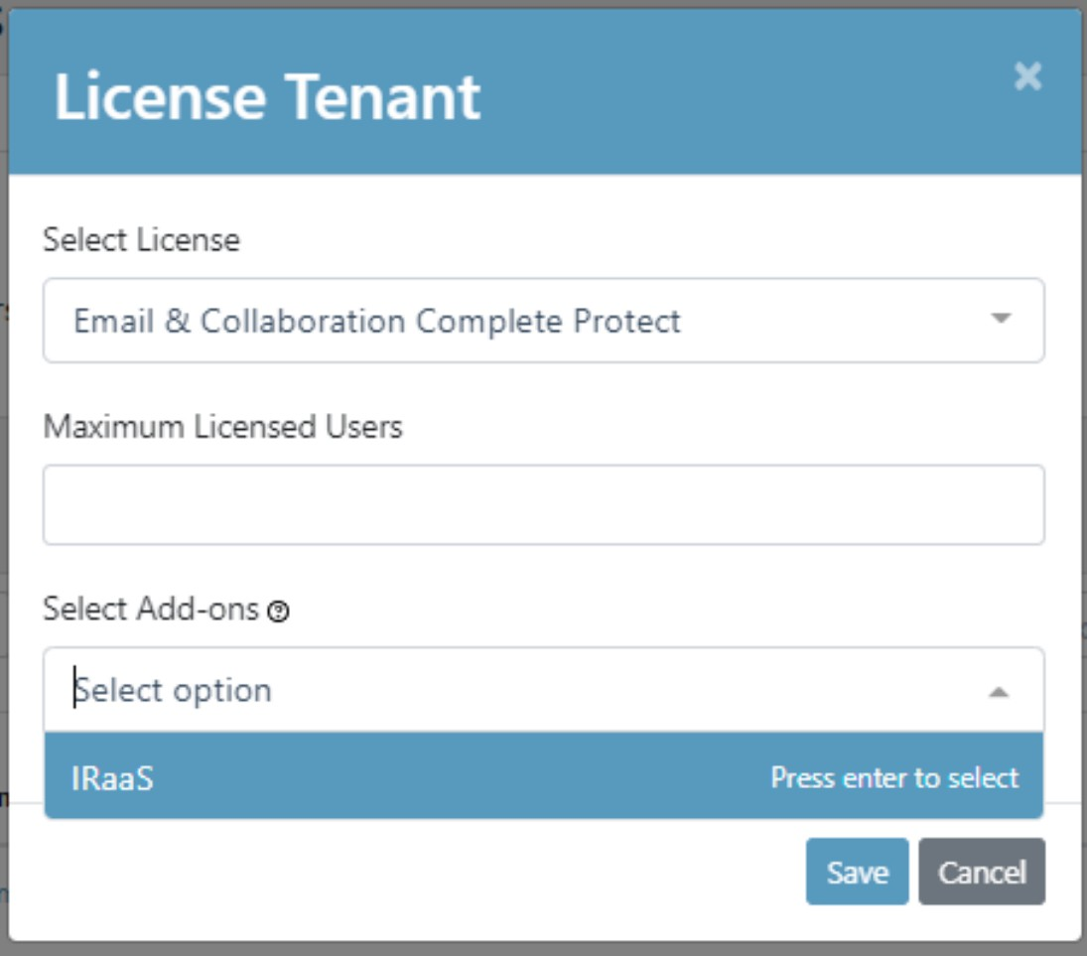
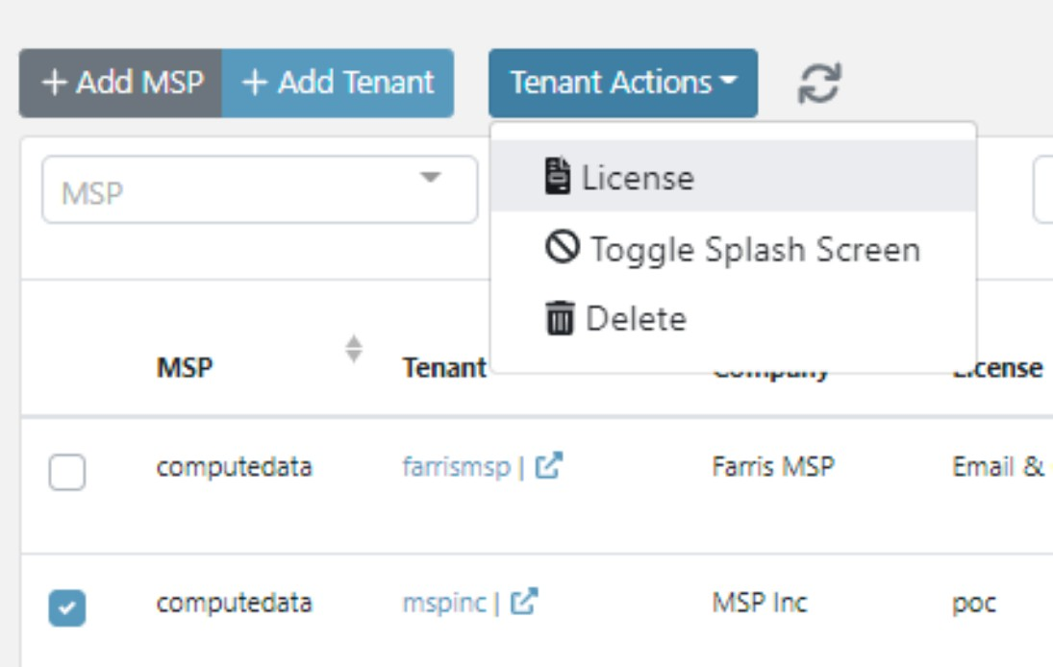
Convert License
Tenant Actions
License Tenant
Tenant Licensed

Slide 39
Important information
Some customers have complex or hybrid email setups.
Some mailboxes are on premises, others are cloud based.
The email is first routed to the on-premises servers and from there to the cloud.
The email is first routed to the cloud and from there to the on-premises servers.
It is very important to understand each customer’s configuration to know what deployment is needed and to troubleshoot issues.
Ask your account representative

Slide 40
THE END
Thank you!
©2022 Check Point Software Technologies Ltd. 40

